Slide 1
JPEG Image Retrieval Scheme
Research Internship IIITN
Notes:
A Privacy-Preserving JPEG Image Retrieval Scheme Using the Local Markov Feature and Bag-of-Words Model in Cloud Computing Jinan University, China

Slide 2
Introduction
Increased Image Generation
Upload their images to the cloud server to save the local storage
Privacy becomes a concern..
Loss of Control Over Images
Security Breaches
Internal Threats
Burden of Encryption
Notes:
This is particularly concerning because images often contain sensitive information.
A recent TechCrunch report showed that Instagram leaked 49 million users’ sensitive data, exposing them to Internet [2]. The iCloud celebrity photo leakage also illustrated the danger of image outsourcing
Malicious, disgruntled employees
CBIR service not provided by cloud. Download all, decrypt, and search entire DB

Slide 3
Problem Statement
Develop a privacy-preserving JPEG image retrieval scheme.
Compatible with JPEG compression
Minimize file size expansion and computational overhead.
Notes:
CBlR while maintaining the privacy of the images.
compatible with JPEG compression-images remain encrypted and secure during retrieval.
The encrypted image should not be significantly larger than the original image. The process of encrypting and decrypting images should require as little additional computing power and time as possible. As on the cloud now, this makes it efficient.

Slide 4
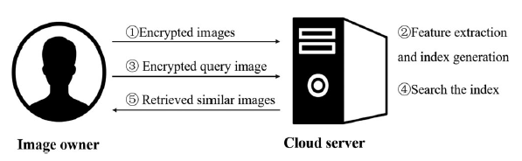
Proposed solution
Two entities: the image owner and cloud server
The image owner encrypts the images and uploads them to the cloud server
Cloud calculates features from the ciphertext images to provide the similar image retrieval service
If the owner needs to retrieve the similar images to a query, he encrypts the query image and sends it
The cloud extracts features from it and search the similar ones by comparing the distances between the feature vector of query image and that of database images
Similar images are return to the owner for decryption

Slide 5
Contd.
Semi-honest cloud:
Provides storage and searching services
Curious of data it stores in it.
Access pattern leakage is not considered
Although the cloud doesn’t know the content, it knows that images are similar; tradeoff
Design Goals:
Accuracy: only similar image retrieval
Security: content of image should be protected by the cloud
Relief on Owners Burden
Notes:
May learn or infer form it
During retrieval
Although images are private-make out which images are similar
….
Thru encryption
Just encrypt and upload-many tasks in cloud itself

Slide 6
Methodology
JPEG compression process
Image Encryption
Feature Extraction (Local Markov Model)
Bag of Words Model
Image Search

Slide 7
Jpeg Compression process
Why JPEG?
86% images are JPEG
High compression ratio
Good image quality
DCT based compression
Lossy compression
The process is as follows:
Notes:
Lossy: some things are permanently removed from the image to reduce size

Slide 8
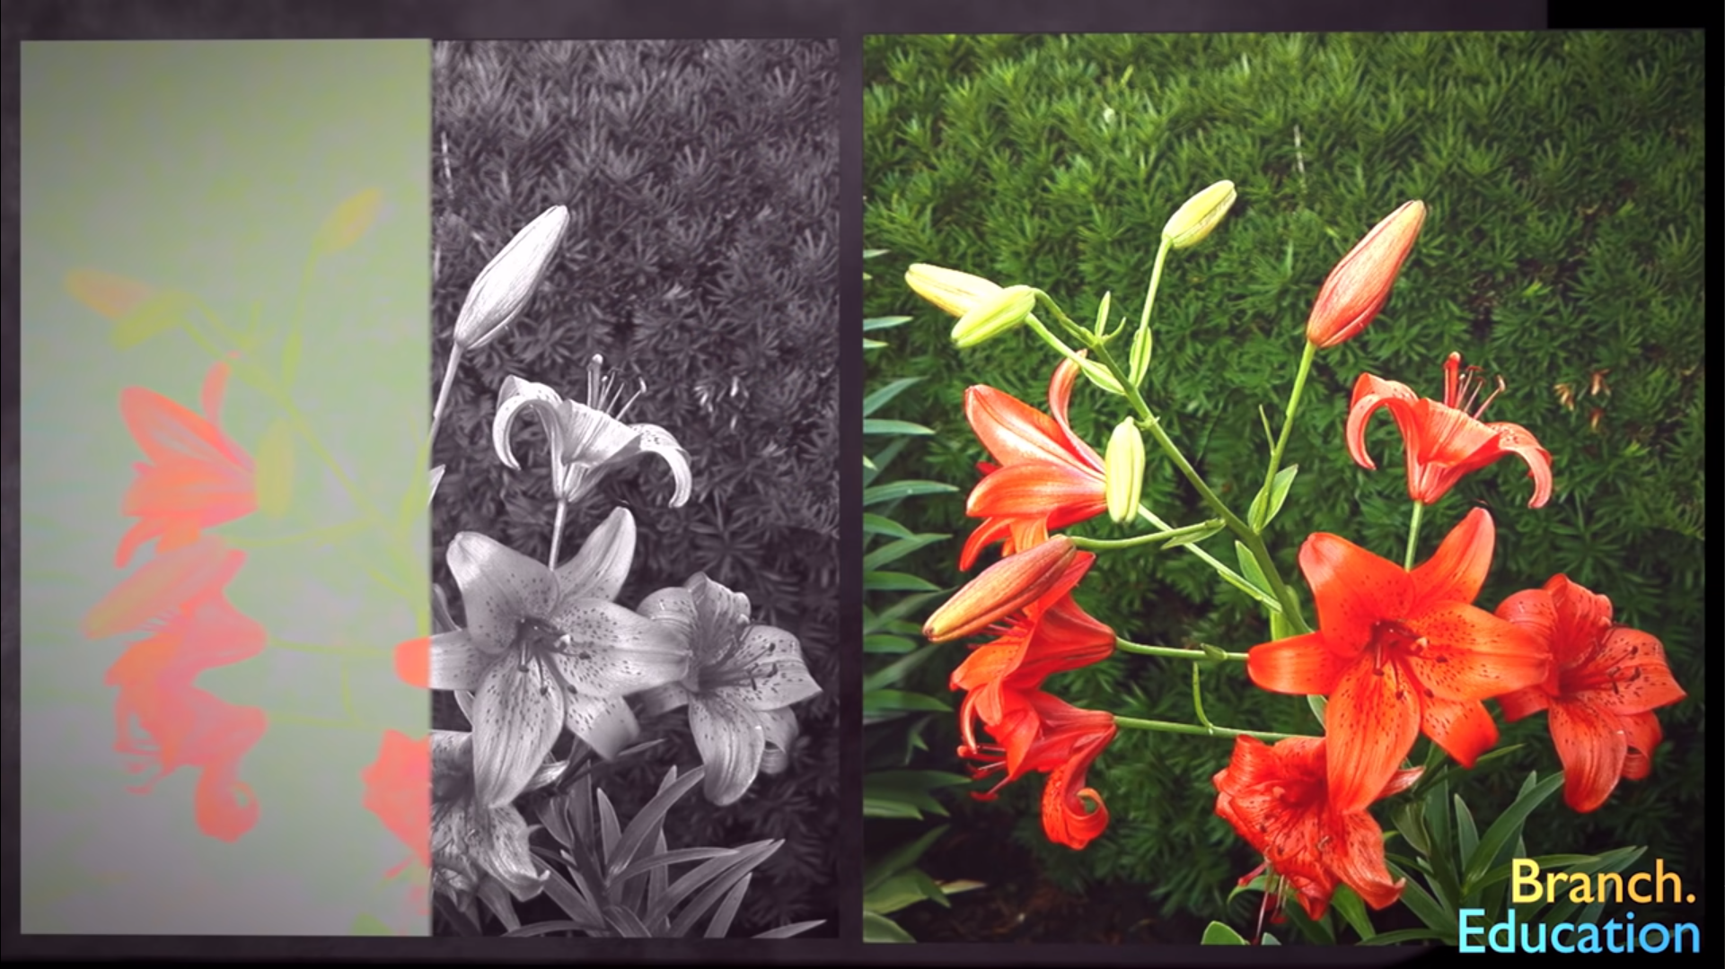
1. Color Space Transformation:
images are generally in RBG format
need to be converted to YUV format
Y: Luminescence (brightness)
U,V: Chrominance (color info) (blue and red difference chroma)
This can be more compressed as it isn’t instantly visible to eyes (rods>>cones)
Rods receptive to brightness, Cones to colors

Slide 9
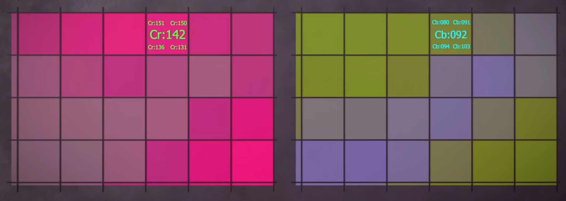
2. Chrominance down-sampling:
The average of adjacent blocks is taken for U and V values
For two blocks, just the average is being stored and not the individual values
Not instantly visible to eyes
Reduces memory

Slide 10
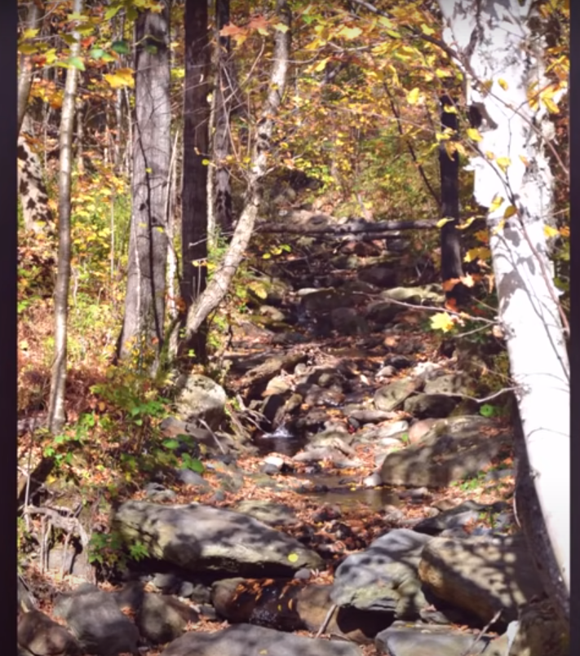
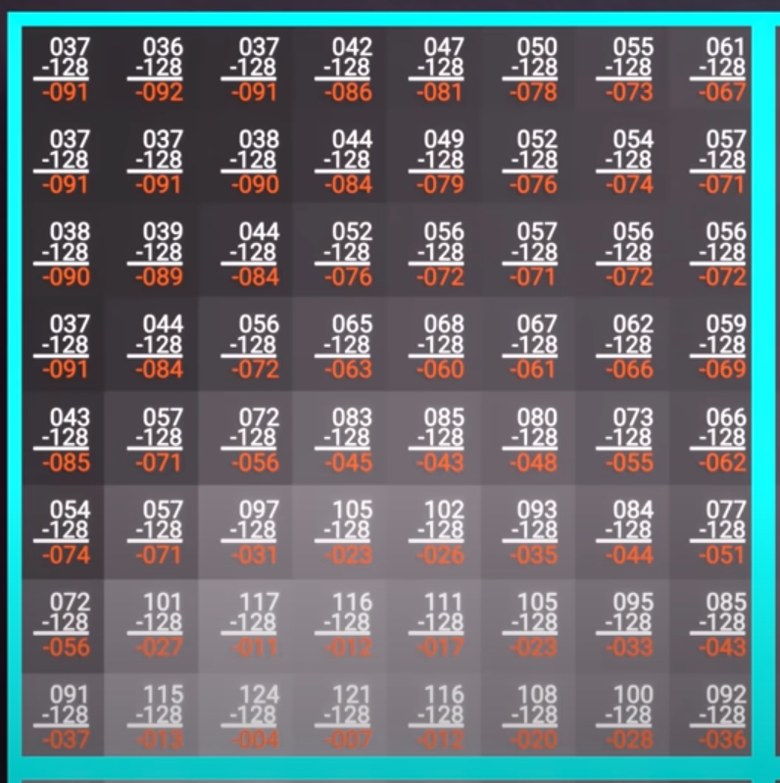
3. Discrete cosine transformation (dct):
Based on High Frequency elements are not perceived
These elements are removed in this
Image is divided into 8*8 blocks called big blocks
Subtracted by 128, and then multiplied by a constant denoting the use of that pixel in image.

Slide 11
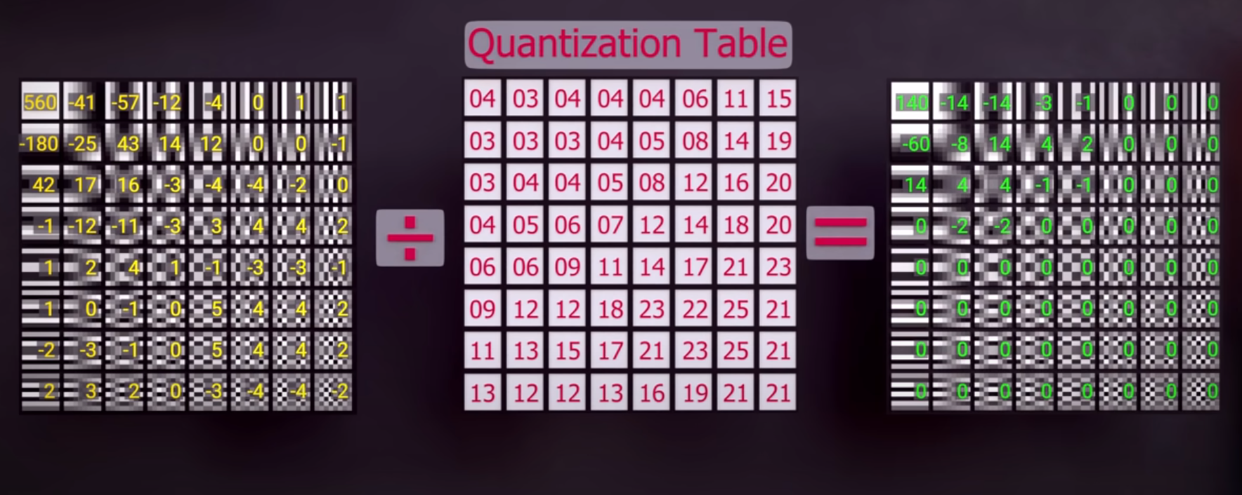
4. Quantization:
Elements are divided by quantization table’s corresponding values
The table has higher values distributed according to their frequency in the image
Numbers rounded to nearest integer

Slide 12
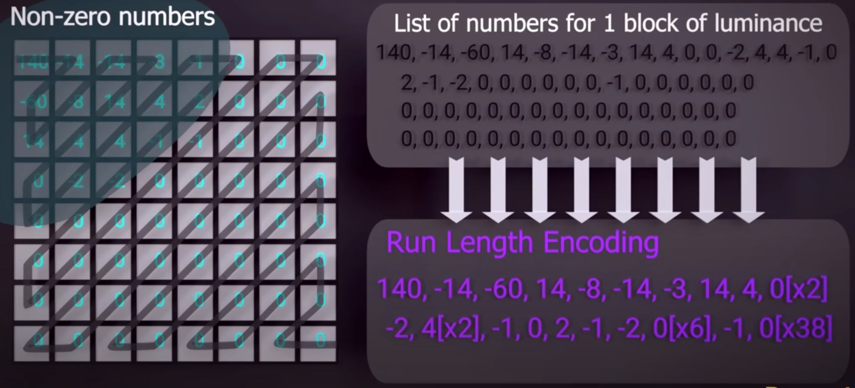
5. Intermediate Encoding:
The elements taken in zigzag order
Elements are stored in (r,v) format
r is the run-length; number of zeroes before a non zero integer
v is the numerical value present
This requires less memory space then storing 64 numbers

Slide 13
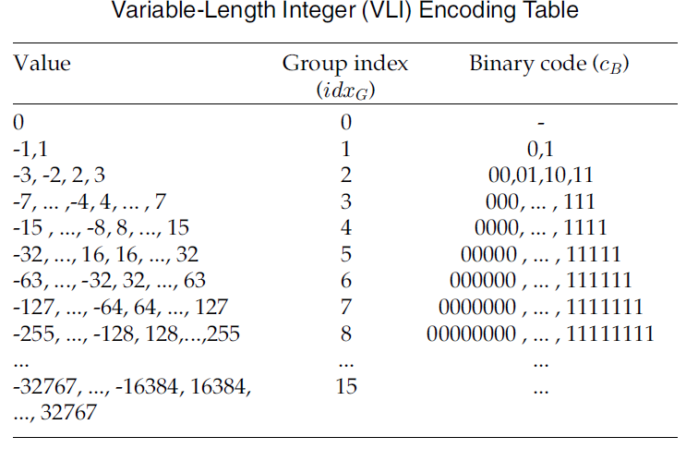
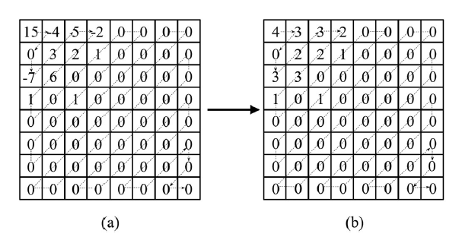
6. Entropy encoding:
The value v in (r,v) pair is then encoded to be a group index idxG and a VLI binary code cB according to the Variable-Length Integer (VLI) encoding table.

Slide 14
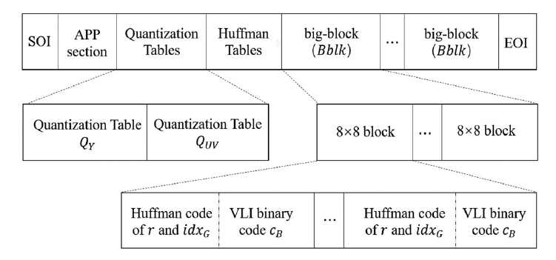
Contd.
Finally, the DCT coefficients are encoded as the triplets (r,idxG,cB)
JPEG image file is made up of these binary data and some other format information.

Slide 15
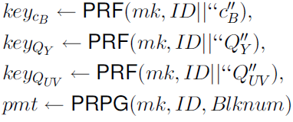
Image encryption
Run Length (r) and group index (idxG) are not encrypted
The encryption takes place in:
VLI Binary code
Quantization table
Big block
PRF: Pseudo Random Number Generator
PRPG: Pseudo Permutation Number Generator
As shown in fig;
PRF generates a random sequence using mk (a declared main key) and the result of the concatenation operation of ID (unique image identifier) and the concerned data (cb/Qy/Quv)
PRPG generates permutation based on mk, ID and Blknum (number of big blocks)

Slide 16
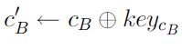
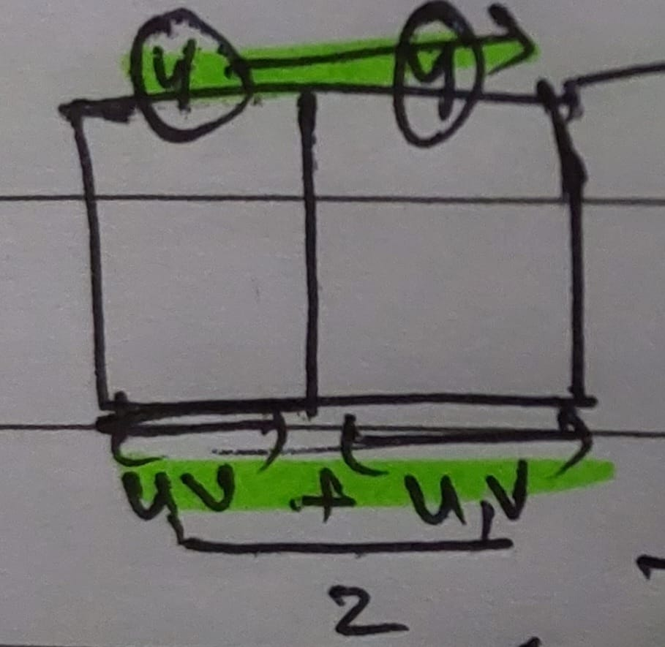
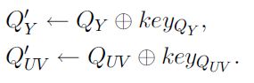
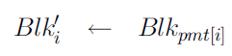
Contd.
VLI Binary Code Encryption:
Quantization Table Encryption:
Big Block Permutation:
Pmt generates an order
Stored in Blki’
During down-sampling, Y component remains twice the U and V. So to keep the number of big blocks constant, we double it.

Slide 17
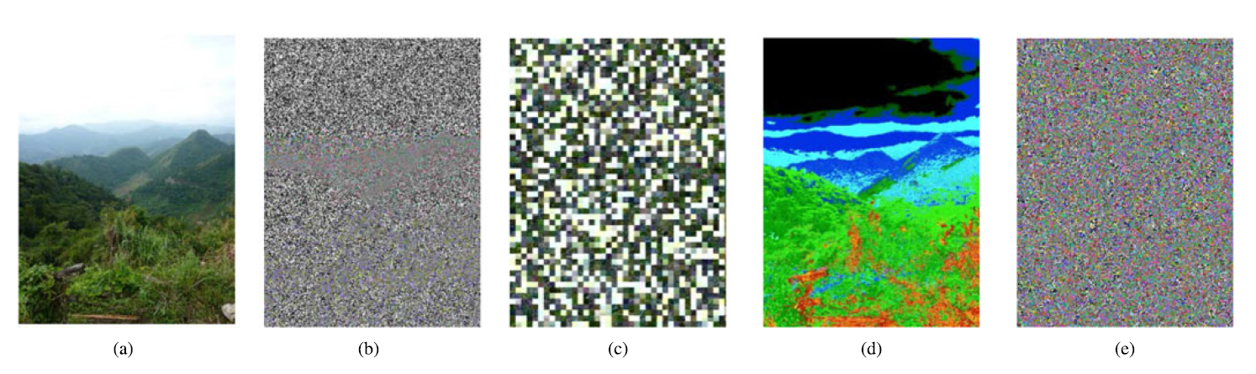

Slide 18
Feature extraction
Using the encrypted binary code cb’ , and unencrypted run-length r and group index idxG, we construct a matrix D
Similar to D, another matrix R is formed by mapping idxG values of the corresponding DCT blocks in matrix D

Slide 19
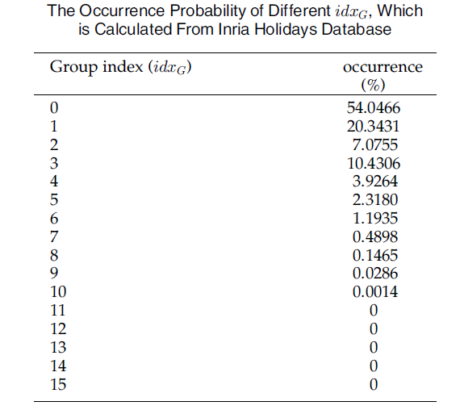
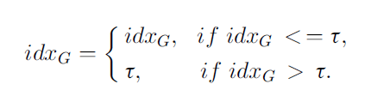
Contd.
Data Truncation: idxg values typically fall between 0-15, most of them being in o-6. therefore the data is truncated based on a constant

Slide 20

Local Markov model
Features are now extracted from R for each big block
Three types of features are calculated:
Intra Block Features: features extracted from a single block, dependency of adjacent DCT coefficients in a 8*8 block
Inter Block Features: features extracted from adjacent 8*8 blocks n four directions; horizontal, vertical, diagonal, and mirror-diagonal
Inter component features: dependency of DCT coefficients among 3 color components.
Each of these 3 generates a feature vector.
After adding all of them, it generates a feature vector for each of the 8*8 blocks as: 18*($τ+1$) *($τ+1$)

Slide 21
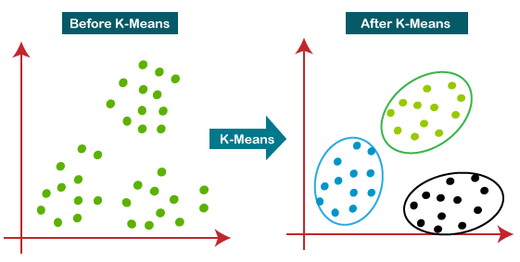
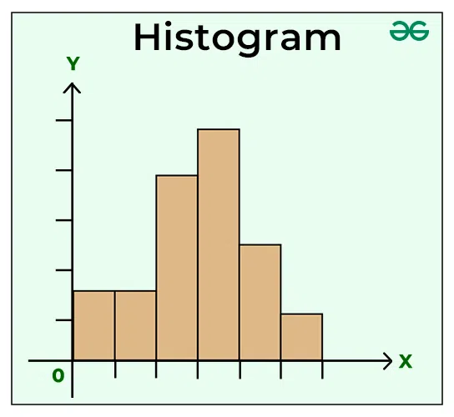
Bag of words model
The local features are generated using the K-Means algorithm
This results in clusters, with the centers as the visible words
These words when grouped together form a Vocabulary
Histograms of these words are generated according to their occurrence. It is normalized according to the words present
These histograms are then used for similarity detection with cipher-text query images

Slide 22
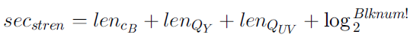
Results
Security analytics:
An PPCBIR scheme generally considers an semi-honest cloud server
The cloud is considered as the only adversary in this scheme
Adversary can only execute a brute-force attack on the encrypted image
The Security Strength secstren is equal to
When the image size is 64*64; lencB, lenQY , lenQUV , and Blknum equals 5504, 512, 512, and 64. Then, we get a 6824 bits key space which can be computationally secure under current computation power

Slide 23
Contd.
Quantization table alone doesn’t encrypt that good. But along with others, it works best.
Lower time consumption then other present methods, but more encryption overhead. It is time consuming, but accurate in retrieval
Encryption is compatible to JPEG compression and make no change in size

Slide 24
Future works
Deep learning: achieved great success in plain image retrieval promising way to learn effective features
Security: the method has group index and run-length unencrypted. But there is a tradeoff between security and searching, and retrieval accuracy
Time efficiency: performs high complexity feature extraction rather than simple statistics. It is acceptable, but there's still room for improvement

Slide 25
Thank you

